Slide 1
Letterboxd Data Analysis Evaluating my movie-rating behavior by training predictive models on personal data
Nick Wibert
STA4241
Dec. 8, 2021

Slide 2
Introduction
Letterboxd
Movie diary tool / social
log films, rate out of 5 stars, write reviews, etc.
I have been logging films since May 2016
Can export data as a .csv
Very basic info + star-rating
Goal: apply classification algorithms covered in the course to evaluate their performance and gain insight on my movie-rating behavior

Slide 3
Data collection
exported data is barebones
Using “rvest” package, wrote a web-scraping script to pull additional covariates from the site
scraped all that was available knowing a lot will be dropped later

Slide 4
Description of data set
Response: Rating
Rating I assigned to the film out of 5 stars
Broken up into increments of 0.5 stars
Ordinal response with 10 levels (0.5, 1, 1.5, …, 4.5, 5)
Numerical covariates
Release Year, Watched.Date, Average.Rating, Runtime (minutes)
Categorical covariates
“Tags” (format), Genre, Country, Language, Studio, various crew members
Goal: using these covariates, train models to classify films into one of the 10 possible classes of Rating

Slide 5
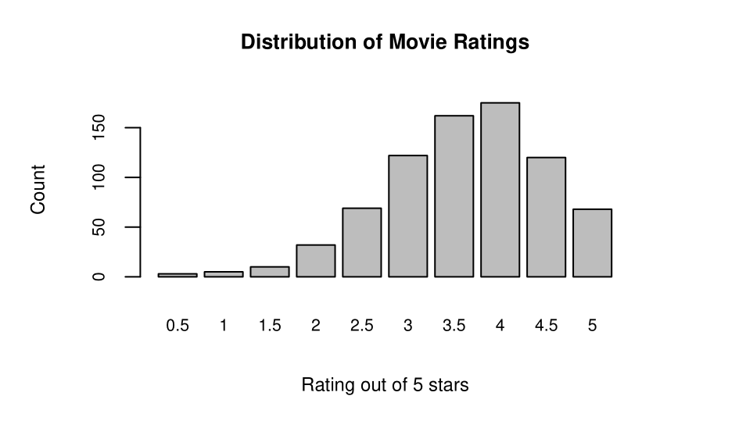
Exploratory data analysis
clear left skew
Imbalanced data set
will need to account for this when resampling
Stratified sampling
“Average.Rating” highly correlated with response
r ≈ 0.8
Expect this to be the most significant covariate in predicting ratings

Slide 6
Exploratory data analysis (cont.)
Many web-scraped covariates were excluded early on
Extremely small coefficients in preliminary models with low significance, linear dependencies
Heavy computationally because of many possible values (30+ categories; for crew members, several hundred)
Variable selection procedures
Best subset selection and backward stepwise regression
Both procedures wittled down to “Average.Rating”, “Watched.Date”, and “as.factor(Tags)”
Best subset also included many levels of “Genre” in the model which maximized the adjusted R-squared

Slide 7
Implementation of classification algorithms
in class, we dealt a lot with binary classification, and several methods had natural extensions to n-level classifications
I performed simulation studies using four of these methods which had natural extensions
LDA, KNN, SVM with polynomial kernel, and SVM with radial kernel

Slide 8
Implementation of classification algorithms (cont.)
What about logistic regression?
We need a modified logit that can handle ordinal response
We discussed baseline-category logit model in class, though this is not often used for classification + I had trouble implementing
Another option is the cumulative logit model with proportional odds (Categorical Data Analysis)
Designed to handle ordinal response
Makes a very strong model assumption of proportional odds
Meaning, the effect of each predictor is the same for each logit
Performed a LR test to test this assumption and ended up rejecting it
Not surprising given the imbalance in the data set
I still implemented the proportional odds model out of curiosity to compare with other methods
Keep in mind that this major assumption is violated so we can’t really use it here

Slide 9
Implementation of classification algorithms (cont.)
Three simulation studies
One using Average.Rating, Watched.Date, as.factor(Tags), as.factor(Genre)
Chosen by best subset
One using the same set, minus Genre
One using only Average.Rating
Loop with 100 iterations
Stratified resampling on each loop with 80%-20% training-test data split
Train each model on training data, run predictions on test data, and store classification error rate
Average error rates over all 100 iterations

Slide 10
Results
Across all three simulations and all models, error rates ranged from 60% to 69% on average
Simulation including Genre had generally higher error rates
Average error rates for models with only Average.Rating were lower than or very similar to error rates for more complex models across the board
Average.Rating weighed very heavily across models, with coefficients in the 4-6 range while absolute values of coefficients for all other predictors was generally less than 1
Models performed relatively similarly across all three simulations

Slide 11

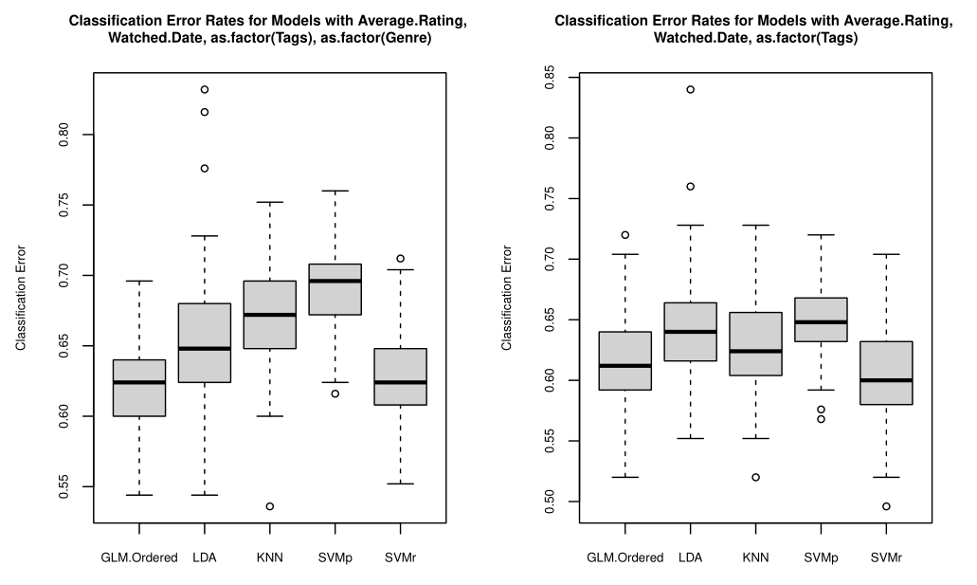
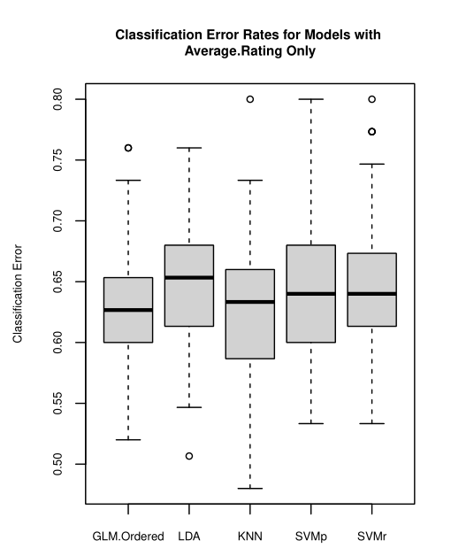
Results (cont.)

Slide 12
Discussion
Predicting human behavior is difficult, especially something as subjective as rating films
While models did not perform spectacularly, this is about what we would expect given the nature of the data set
We need a benchmark to evaluate the performance of the models
Simplest benchmark is random chance: 10% success rate for 10-level classif.
Zero rule: choose majority class (4 stars, ~ 23% of final dataset)
Average success rate was 30-40% on average
While not great, still better than these benchmarks
There’s some level of predictive power, mostly due to Average.Rating

Slide 13
Discussion (cont.)
Average.Rating is the most significant covariate considered by far
Possible explanations
Average rating is one of the last things you see when you pull up a film to rate it
Easy to be slightly / subconsciously influenced by what general audiences think
Or, my taste just tends to align with the population of Letterboxd users
Even when classification failed, it was very often in one of the adjacent classes
Considering Rating as a continuous response and calculating MSE, consistently got MSE ~0.2
Other main covariates considered, Watched.Date and Tags, cannot be extrapolated to films I have not seen yet
I do not know when/how I will watch them

Slide 14
Discussion (cont.)
Weaknesses of data set
The imbalance had clear effects on predictive power
Models tended to fail more often when Average.Rating was in the lower half of ratings
Original data set has far fewer observations in those classes, so it has less to train on
Since exporting the original data set for this project, I have seen 6 movies
True Ratings: 3.5, 5.0, 5.0, 2.0, 3.0, 4.0
None of the models got more than 2 correct
The 2 that were correct were always one of the three higher ratings (4 or 5 stars)
Shows that models are weakest when Average.Rating OR my personal rating are lower, as the models are trained primarily on data in the 3.5 to 5 star range
Stratified resampling helps, but cannot make up for lack of data

